Slide 1
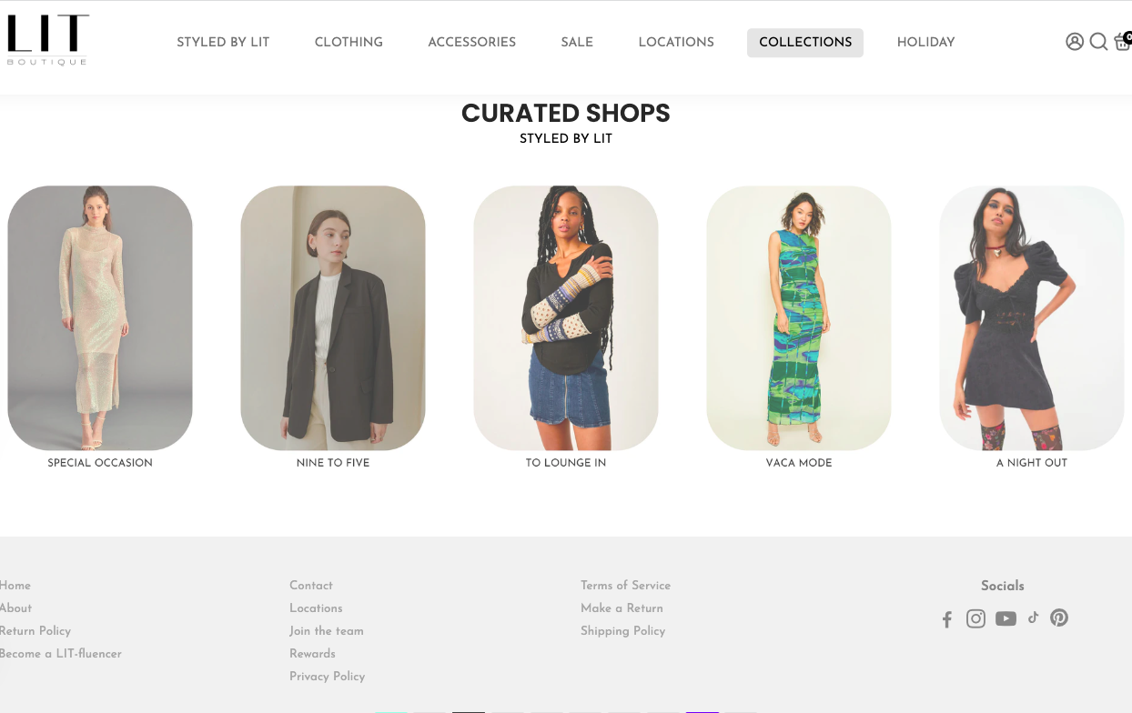
Modeling LIT’s Sales Process to Evaluate Efficiency
LIVE LIT - LIVE LIT – LIVE LIT - LIVE LIT - LIVE LIT – LIVE LIT
LIVE LIT - LIVE LIT – LIVE LIT - LIVE LIT - LIVE LIT – LIVE LIT
GR602 Group 1: AJ Alden, Tajae Edwards, Nadim Fayssal, Nicole Romangsuriat, Nevedtha Venkataraman

Slide 2

Table of Contents
1. Company Background
4. Problem Analysis
2. Process Description
5. Process Analysis
3. Data Collection
6. Recommendations

Slide 3

Company Background
Boston-based fashion company
Offers chic womens’ clothing, shoes, & accessories
Boutique retailer
Does not manufacture, but re-sells
Competitive Advantage - styling services
LIVE LIT - LIVE LIT – LIVE LIT - LIVE LIT - LIVE LIT – LIVE LIT
LIVE LIT - LIVE LIT – LIVE LIT - LIVE LIT - LIVE LIT – LIVE LIT
Notes:
women-led, minority owned, Boston-based fashion company
sell their products through their websites and their 4 brick-and-mortar stores
As a boutique retailer, LIT is in between mass market discount retailers such as TJMaxx and luxury designer brands such as Louis Vuitton
It has slightly higher price ranges and product quality than large mall retailers such as Urban Outfitters and Abercrombie & Fitch. With its product and price offering, it targets metropolitan women in their early twenties to their late forties. With its variety of brands, it provides different styles to consumers segments such as college students and working professionals, which is supported with their store locations in busy New England cities
LIT does not manufacture their own clothing, but re-sells items purchased from various brands that they encounter in trade shows and buyers markets throughout the country
LIT’s competitive advantage is its styling services. Unlike other companies, LIT’s stylists form relationships with customers, obtaining information regarding a customers’ style, brand and material preferences, and specific occasions in shopping visit purposes, to recommend the most suitable items.
This unique service aspect is what attracted us to this company and its sales process.

Slide 4
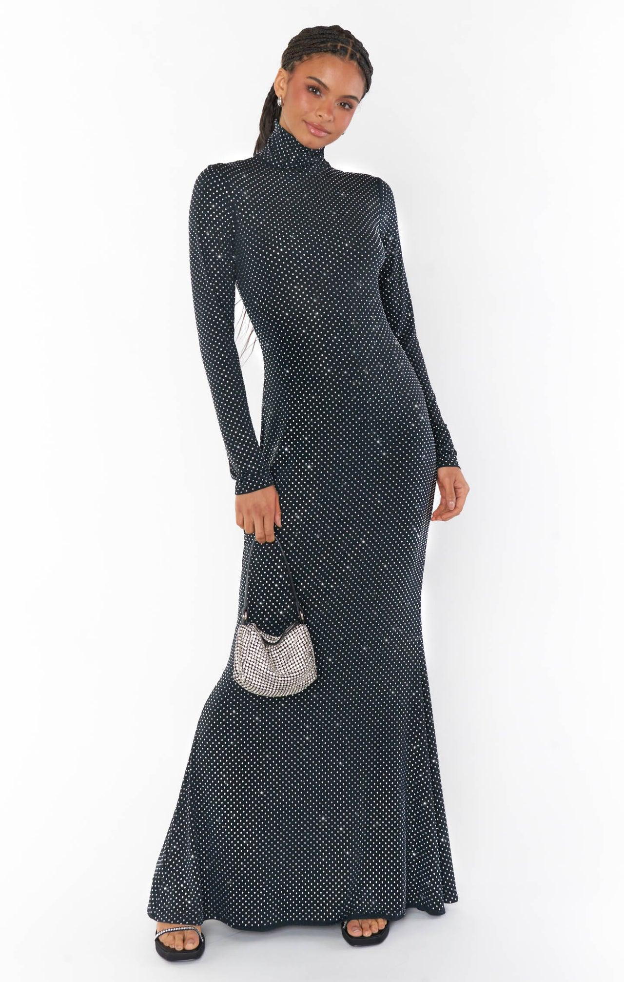
Process Description
In-store customer transactions
How LIT’s stores catered to its customers from their point of entry
Evaluated how the styling service impacts a common retail process
Process Objective: Maximize daily sales transactions
LIVE LIT - LIVE LIT – LIVE LIT - LIVE LIT - LIVE LIT – LIVE LIT
LIVE LIT - LIVE LIT – LIVE LIT - LIVE LIT - LIVE LIT – LIVE LIT
Notes:
Without a need to focus on manufacturing, LIT can prioritize its sales process, especially its core competency of its styling services. We thought it would be interesting to consider how LIT’s stores process in-store customer transactions, and cater to customers from the moment they enter the store to the point where they leave.

Slide 5
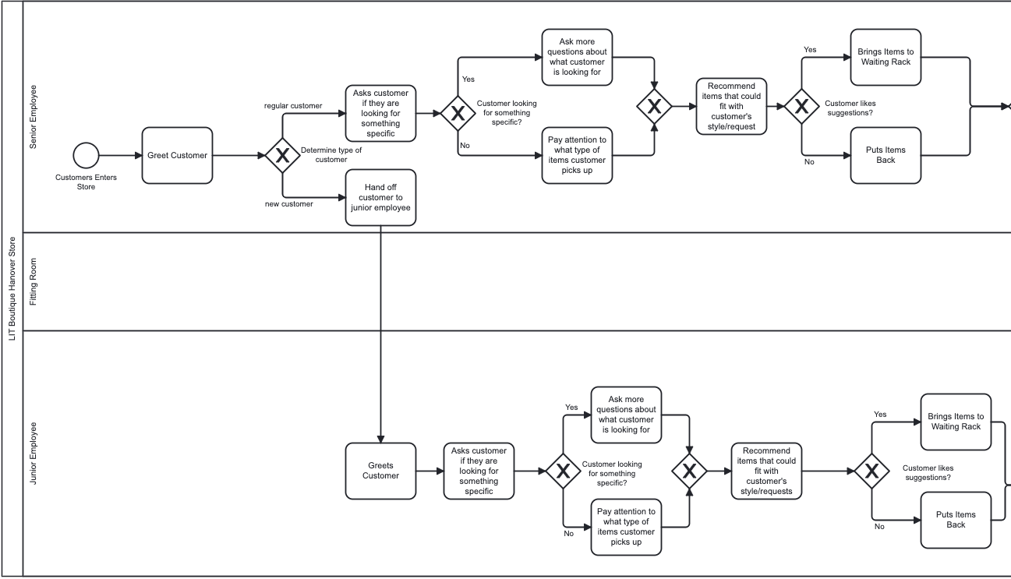
AS-IS Model
Notes:
start point - customer entering the store, four end points - customer leaving the store with various outcomes
end points kept separate for customers who were regulars vs newcomers, and purchases vs without -> obtain metrics for each result
Three agents - senior employee, junior employee, fitting room.
Fitting room is agent despite how customer doing the action, room is simply a physical resource, for easy modeling purposes
important step of trying items on - we need to capture time, could not be placed in a separate pool
process starts by greeting the customer and determining whether the customer is a regular or not -> how we segmented the two customer types.
senior employee works with the regular customer, junior employee works with the new customer
steps are nearly identical for each employee/customer type, will only explain one for the sake of presentation timing

Slide 6
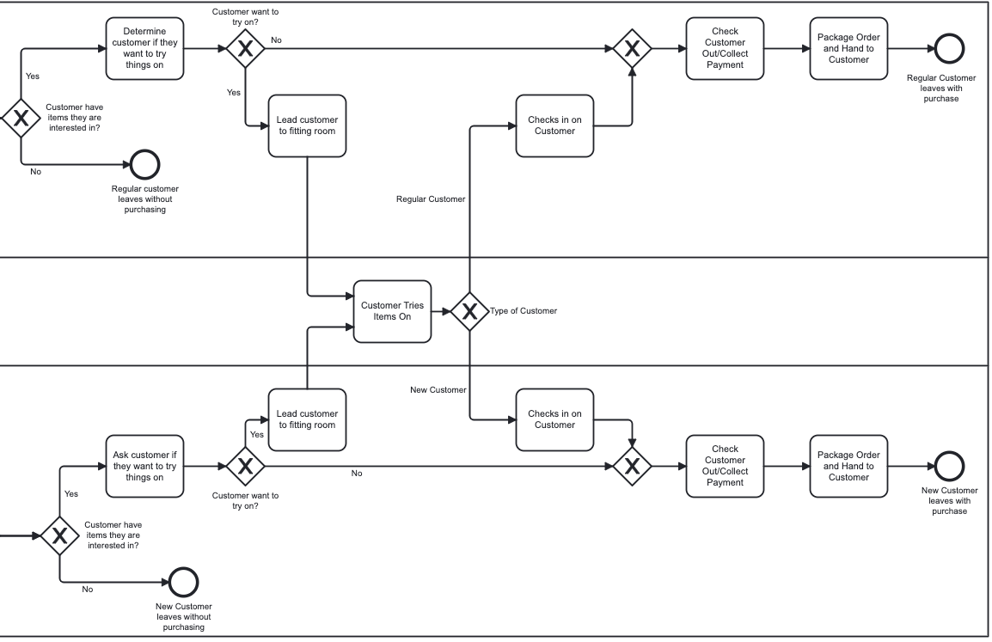
AS-IS Model

Slide 7

Data Collection
Nicole met with Ami (manager) at the North end branch
Determined average percentages for the decision points
Re-created the process in real time to obtain step durations
LIT does not keep record of this data
Notes:
For data collection, Nicole met with Ami to discuss the process details and simulation metrics. They met in the store during opening hours while Ami was on break. After discussion and consulting other employees present at the store, Nicole and Ami determined the average percentages of the decision points and re-created the process in real-time to determine the approximate length of each process step. LIT Boutique is a small company that does not keep track of these metrics. As Nicole and Ami both have 3 years of experience working in this company, this was the most reliable way of obtaining this information.

Slide 8



Problem Analysis
Slow retail days (Mondays, Tuesdays, rainy days): a common retail problem
Low customer traffic in a slow retail day
Small Throughput
Decreased Sales
Low Employee Utilization
Focus the process on slow retail days
Notes:
Lack of steady traffic during slow retail days; days where people are either busy with work during the start of the week or prefer to stay indoors because of the bad weather
External factor relating to the customers’ working lifestyles and environmental factors that is difficult to address
For LIT: slow traffic = 2 or 3 customers walking in every hr vs 10 on the weekends
Small throughput (customer transactions)
Decreased sales -> smaller budget for buying and employee wages
Stores being in popular tourist shopping areas -> policy of 2 employees working at a time for employee safety and theft prevention
Store employees focus on the sales process, don’t have the ability to influence customer traffic (job of office and marketing team)
Without customers, employees will have extended periods of time without customers to cater to
Low utilization -> hours are cut to prevent resource overallocation (worse for employees making minimum wage and want to work more hours) + low morale
each employee working with 1-2 customers at a time, created a more streamlined straight forward process

Slide 9

Process Analysis (Simulation Features)
Resource Consumption
Employee utilization
Cycle Time/Waiting Instances
Customers stuck in between steps
Different End Point Results
Customers with purchases and sales estimates
Notes:
Resource Consumption - consider employee utilization with this process to determine allocation of tasks/responsibilities for the day
Cycle time - increasing to make customers stay longer in store -> increasing likelihood of purchasing, and increasing employee utilization
Waiting instances -> if customers are waiting in between the steps
Data on customers leaving the store with/without purchases

Slide 10

Good
Bad
No customers waiting in between each step
Activities are well spaced out
Step durations are well-allocated
Generating over $2000 a day after wages
Still making a steady profit
5 customers a day leaving without purchasing
A metric to improve on
56.5%, 40%, 10.7%
Low resource utilization

Slide 11

Assign Other Tasks Unrelated to the Process
Recommendations
Plan Events in the Store During the Slow Days
Use the first fitting room as a display
Notes:
Assign other tasks - cleaning, inventory management, text regular customers about available items of interest to increase customer traffic
Boost employee utilization overall!
Plan events in the store that are collaboration efforts with other stores in the area, provide a reason for customers to enter the store on a slow retail day, increase the sense of community and partnerships with other brands/stores
Increase the time a customer is in the store by influencing them to look at the items before walking into the fitting rooms
Potentially increase likelihood of purchasing
Increase resource utilization for fitting room as well

Slide 12


Assumptions,
Limitations
Large variability in timing and decision point percentages
Analysis is based on estimates, not actual recorded data
Real data might not be feasible for a small company to track
Notes:
Numbers used in simulation are estimates, small company that does not invest in analytics, track real data in terms of process durations, limited information regarding conversion that we could not obtain access to

Slide 13

LIVE LIT - LIVE LIT – LIVE LIT - LIVE LIT - LIVE LIT – LIVE LIT
Thank you.
Questions are welcome.

